Slide 1
SQL Server Performance Tuning
مدرس : حمیدرضا صادقیان

Slide 2
How SQL Server Works
TDS/Network Protocols
SQL Server is a Client/Server platform
Tabular Data Stream(TDS) protocol
Application-level protocol
Designed over TCP/IP and Named Pipes
ODBC,JDBC,OLE DB use TDS
TCP/IP
Default port = 1433
SQL Server Browser UDP=1434

Slide 3
How SQL Server Works
SQLOS
Managing all OS resources
Non-preemptive scheduling
Memory and buffer management
I/O functions
Resource Governance
Exception handling
Xevents

Slide 4
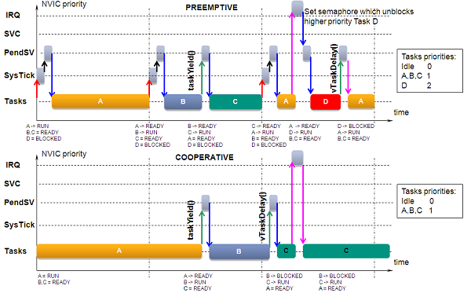
How SQL Server Works
SQLOS
Preemptive vs Non-Preemptive or Cooperate scheduling

Slide 5
How SQL Server Works
Schedulers
Responsible to manage working threads called workers.
Each scheduler has at most one task in running state.
Each schedulers are mapped to an individual logical processor.
Schedulers have an ID number less than 1048576.

Slide 6
How SQL Server Works
Tasks
IS an execution request and represents the work that needs to be performed while a worker maps to an operating system thread
States
Pending: Task is waiting for an available worker
Done : Task is completed
Running : Task is currently executing on the scheduler
Runnable : Task is waiting for he scheduler to be executed
Suspended : task is waiting for external event or resource
Spinloop :Task is processing a spinlock

Slide 7
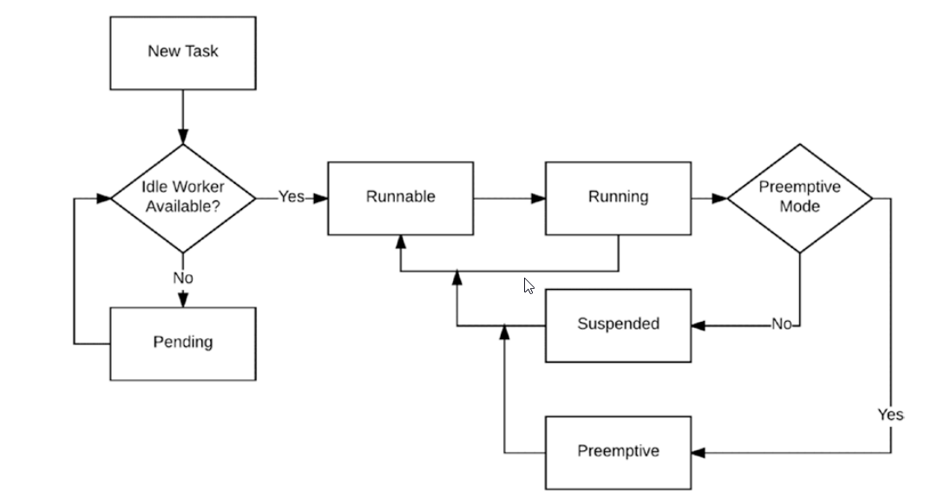
How SQL Server Works
Tasks
Task Execution process

